Slide 1


JEPPIAAR INSTITUTE OF TECHNOLOGY
“Self-Belief | Self Discipline | Self Respect”
Department of Electronics and Communication Engineering
Subject Name :WIRELESS NETWORK Presentation Title: AMPS(ADVANCED MOBILE PHONE SERVICE)
Team Members:
Students Name Reg.No:
1.Vetrivel L 210617106084
2.Vignesh M 210617106088
3.Vignesh P 210617106087
4.Shachinkguru S 210617106074
5.Supraja T 210617106077
6.Vidhyalakshmi M 210617106086

Slide 2
OBJECTIVE What is amps?
Advanced Mobile Phone Service (AMPS) is a standard system for analog signal cellular telephone service in the United States and is also used in other countries. It is based on the initial electromagnetic radiation spectrum allocation for cellular service by the Federal Communications Commission (FCC) in 1970.
AMPS allocates frequency ranges within the 800 and 900 Megahertz (MHz) spectrum to cellular telephone. Each service provider can use half of the 824-849 MHz range for receiving signals from cellular phones and half the 869-894 MHz range for transmitting to cellular phones. The bands are divided into 30 kHz sub-bands, called channels. The receiving channels are called reverse channels and the sending channels are called forward channels. The division of the spectrum into sub-band channels is achieved by using frequency division multiple access (FDMA).

Slide 3
Introduction of amps
Advanced Mobile Phone System (AMPS) was an analog mobile phone system standard developed by Bell Labs, and officially introduced in the Americas on October 13, 1983,^{[1][2][3]} Israel in 1986, Australia in 1987, Singapore in 1988, and Pakistan in 1990.^{[4]} It was the primary analog mobile phone system in North America (and other locales) through the 1980s and into the 2000s. As of February 18, 2008, carriers in the United States were no longer required to support AMPS and companies such as AT&T and Verizon Communications have discontinued this service permanently. AMPS was discontinued in Australia in September 2000, in Pakistan by October 2004,^{[4][5]} in Israel by January 2010, and Brazil by 2010.^{[6]}

Slide 4
Evolution of amps
The first cellular network efforts began at Bell Labs and with research conducted at Motorola. In 1960, John F. Mitchell,^{[7][8][9]} an electrical engineer who had graduated from the Illinois Institute of Technology, became Motorola's chief engineer for its mobile-communication products. Mitchell oversaw the development and marketing of the first pager to use transistors.
Motorola had long produced mobile telephones for automobiles, but these large and heavy models consumed too much power to allow their use without the automobile's engine running. Mitchell's team, which included the gifted Dr. Martin Cooper, developed portable cellular telephony, and Mitchell was among the Motorola employees granted a patent for this work in 1973. The first call on the prototype connected, reportedly, to a wrong number.^{[10][11]}
While Motorola was developing a cellular phone, from 1968-1983 Bell Labs worked out a system called Advanced Mobile Phone System (AMPS), which became the first cellular network standard in the United States. The first system was successfully deployed in Chicago, Illinois, in 1979. Motorola and others designed and built the cellular phones for this and other cellular systems.
Martin Cooper, a former general manager for the systems division at Motorola, led a team that produced the DynaTAC 8000x, the first commercially available cellular phone small enough to be easily carried, and made the first phone call from it. He later introduced the so-called Bag Phone.
In 1992, the first smartphone, called IBM Simon, used AMPS. Frank Canova led its design at IBM and it was demonstrated that year at the COMDEX computer-industry trade-show. A refined version of the product was marketed to consumers in 1994 by BellSouth under the name Simon Personal Communicator. The Simon was the first device that can be properly referred to as a "smartphone", even though that term was not yet coined.^{[12][13]}

Slide 5
Amps facts
Analog FM modulation
RF bandwidth 30 kHz. The band can accommodate 832 duplex channels, among which 21 are reserved for call setup, and the rest for voice communication.
Frequency allocated by FCC on 824-849 MHz for downlink and 869-894 MHz for uplink traffic.
Uses the same system throughout the US
Available in U.S., Canada, Hong Kong, New Zealand, Thailand
A narrowband versus exists with a 10 kHz channel spacing, such that 2496 channels can be assigned, in stead of 832 for the normal AMPS mode.

Slide 6
Features of amps
It is an analog system based on the initial electromagnetic spectrum allocation for cellular service by the Federal Communications Commission.
It uses frequency division multiple access (FDMA) for multiple simultaneous conversations.
Frequency ranges within the 800 and 900 MHz are allocated for cellular telephones in AMPS. Half of the signal is used for sending signals and half is used for receiving signals.
It has a high bandwidth requirement particularly when the number of conversations is very high.
It was the first system to use hexagonal cells. So, the pioneers of AMPS had coined the term coined cellular.
The cells in AMPS are 10km to 20 km across.
Since, it was an analog technology, it suffered from noise and eavesdroppin

Slide 7
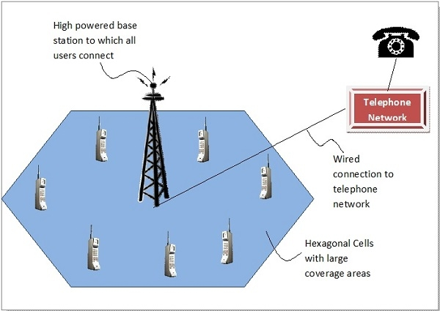

Slide 8
AMPS TECHNOLOGY
AMPS is a first-generation cellular technology that uses separate frequencies, or "channels", for each conversation (see frequency-division multiple access (FDMA)). It therefore required considerable bandwidth for a large number of users. In general terms, AMPS was very similar to the older "0G" Improved Mobile Telephone Service, but used considerably more computing power in order to select frequencies, hand off conversations to PSTN lines, and handle billing and call setup.
What really separated AMPS from older systems is the "back end" call setup functionality. In AMPS, the cell centers could flexibly assign channels to handsets based on signal strength, allowing the same frequency to be re-used in various locations without interference. This allowed a larger number of phones to be supported over a geographical area. AMPS pioneers coined the term "cellular" because of its use of small hexagonal "cells" within a system.^{[14][15]}
AMPS suffered from many weaknesses compared to today's digital technologies. As an analog standard, it was susceptible to static and noise, and there was no protection from 'eavesdropping' using a scanner.

Slide 9
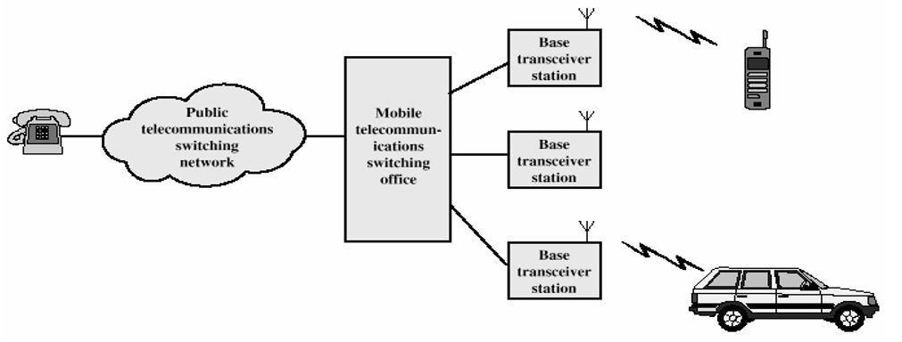
AMPS Architecture

Slide 10
RESULT AND DISCUSSION
The signals received from a transmitter cover an area called a cell. As a user moves out of the cell's area into an adjacent cell, the user begins to pick up the new cell's signals without any noticeable transition. The signals in the adjacent cell are sent and received on different channels than the previous cell's signals to so that the signals don't interfere with each other.
The analog service of AMPS has been updated with digital cellular service by adding to FDMA a further subdivision of each channel using time division multiple access (TDMA). This service is known as digital AMPS (D-AMPS). Although AMPS and D-AMPS originated for the North American cellular telephone market, they are now used worldwide with over 74 million subscribers, according to Ericsson, one of the major cellular phone manufacturers.

Slide 11
FUTURE SCOPE
Smart phones, personal digital assistants (PDAs), tablets and other mobile devices currently being used in the world have made mobile computing exceptionally handy. The mobility of these innovative gadgets enables their users to access almost all computer based services.These advanced technological devices can create or upload files, browse the internet, stream live videos at high speeds and also do video or voice conferencing.
The exponentially increasing demand for better and quality devices has been as a reason for market growth. Manufacturers of these devices are having sleepless nights seeking to get their own big share of the market.

Slide 12
REFERENCE
http://www.iaster.com/uploadfolder/4LatestTechnologyofMobileCommunicationandFutureScopeof7/4Latest%20Technology%20of%20Mobile%20Communication%20and%20Future%20Scope%20of%207.5G%20OL15Aug14%20Copy.pdf
Chen, HH; Guizani, M; Mohr, W (2007), “Evolution toward 4Gwireless networking”, IEEE Network, Volume: 21 Issue: 1 pp. 4-5.

Slide 13
THANK YOU

